Slide 1
KP BATTERY ANALYSIS
Analysis by:
Kibet Evans & Theodore Kamau

Slide 2
Issue Definition
What We Know
KP Battery Longevity
Analyze
Conclusions

Slide 3
Issue Definition
14 KPs are reported to have batteries draining within 12h when the mains supply is unavailable.
The list of affected KPs as shared by NOC is detailed in Power Supply Audits sheet.
The objective is to determine how long a battery on an active KP should last and is to identify the possible causes of the rapid depletion of KP battery.

Slide 4
What We Know
4 KPs have batteries discharging at a fast rate (3-6h).
14 other battery related issues involve agents switching off the power often, hence batteries do not charge to full capacity and lasts less when KP is switched to battery.
40Ah batteries in the field last less than the manufacturer’s specified duration of about 15h.
Currently UPS charges battery at 1.7A whereas battery datasheet specifies 4A, to charge battery to full capacity in 28h.

Slide 5
Determine the Longevity of KP Battery
Test setup
Fully charge the 5 batteries on the in-house KPs.
Record the starting battery voltage reading and duration it takes to discharge to 12.0V (data was pulled from DB)
Dispense continuously on these KPs to replicate customer sales.
Results
It required more than 24 hours to fully charge an initially depleted KP battery
KP without android box - lasted 9 hours with 40 complete dispenses (2L).
KP with android box - lasted 8 hours during which 8 customer dispensed fuel.

Slide 6
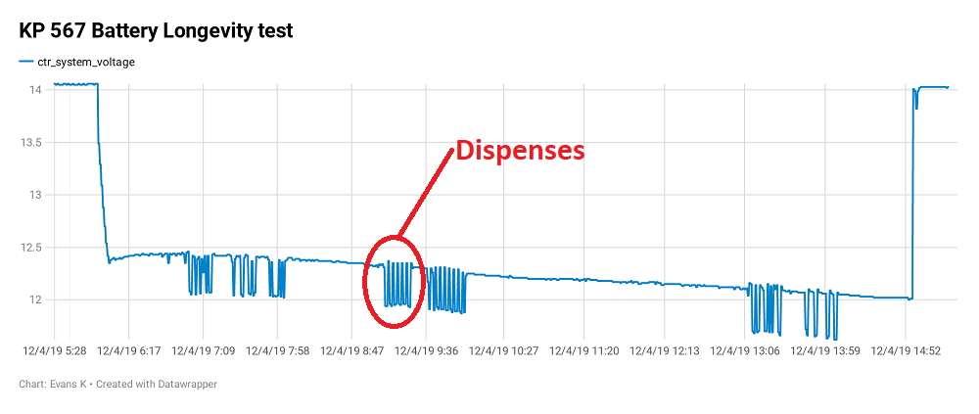
Cont’d: Determine the Longevity of KP Battery
KP lasted 9 hours on battery with 40 dispenses done from when the KP was switched to battery till the battery low threshold was realized.
During dispensing the system voltage dips by an average 0.4V. On completion of the dispense, the voltage recovers to slightly below the starting voltage within 30 sec.

Slide 7

Analyze
Identify possible root causes
Analyze the root causes

Slide 8
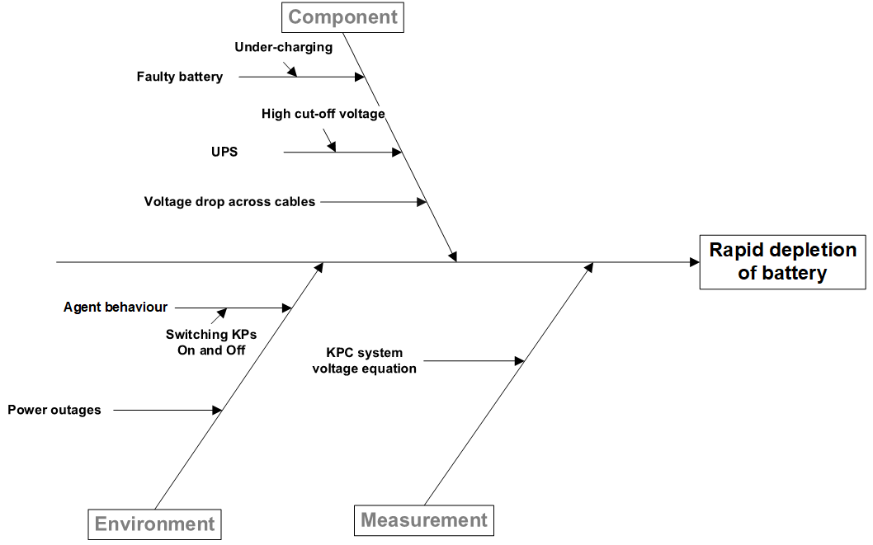
Possible root causes

Slide 9
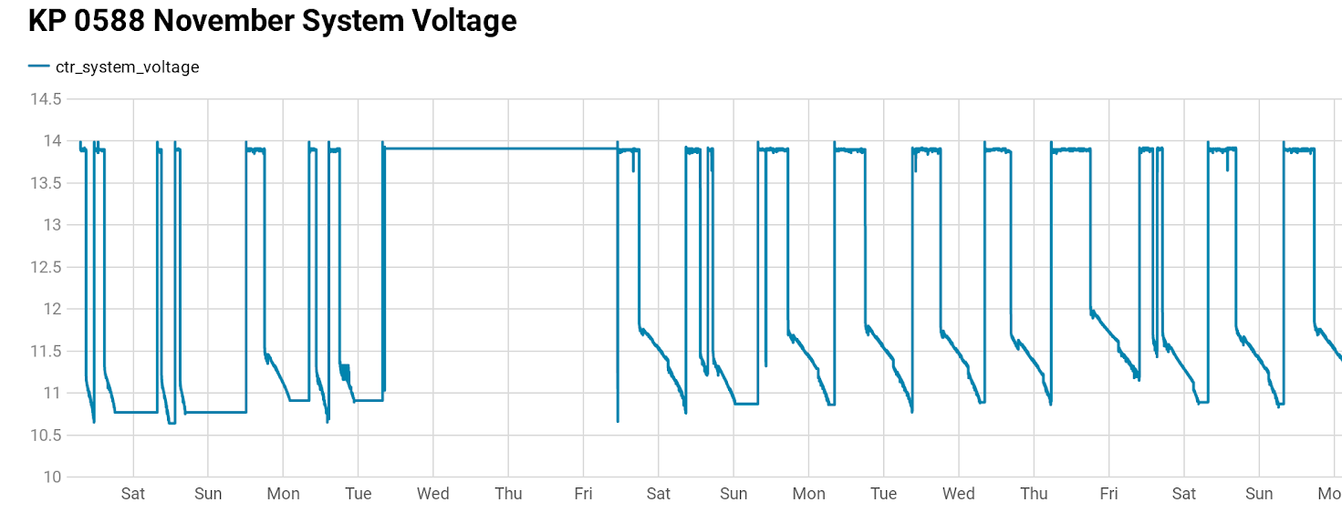
Agent Behaviour Analysis
Data for field KPs was pulled from DB and plotted to visualize the system voltage trends of 6 identified KPs. On average, the KPs were switched on for 10h and off for the remaining 14h. This resulted in batteries not fully charging to 100% thus draining faster.

Slide 10
Cont’d Agent Behaviour
Determine the power consumed/saved when KP is turned OFF at night by agents.
Test 1 KP030 was connected to mains via a power logger and turned off at 8pm and on at 8am for 7 days (152h) to simulate agent behaviour.
Resulted in power consumption rate of 0.52105 KWh/day
Test 2 KP030 was connected to mains via a power logger and kept on mains for 4 days (78h).
Resulted in a power consumption of 0.55385 KWh/day
Impact
The agent incurs more for keeping the KP ON at night by KSh. 20 a month assuming a charge rate of KSh. 20 per unit KWh.
Battery life cycles also drop by over half when agents switch KPs off at night, hence batteries may need replacement sooner than it would have originally lasted.

Slide 11
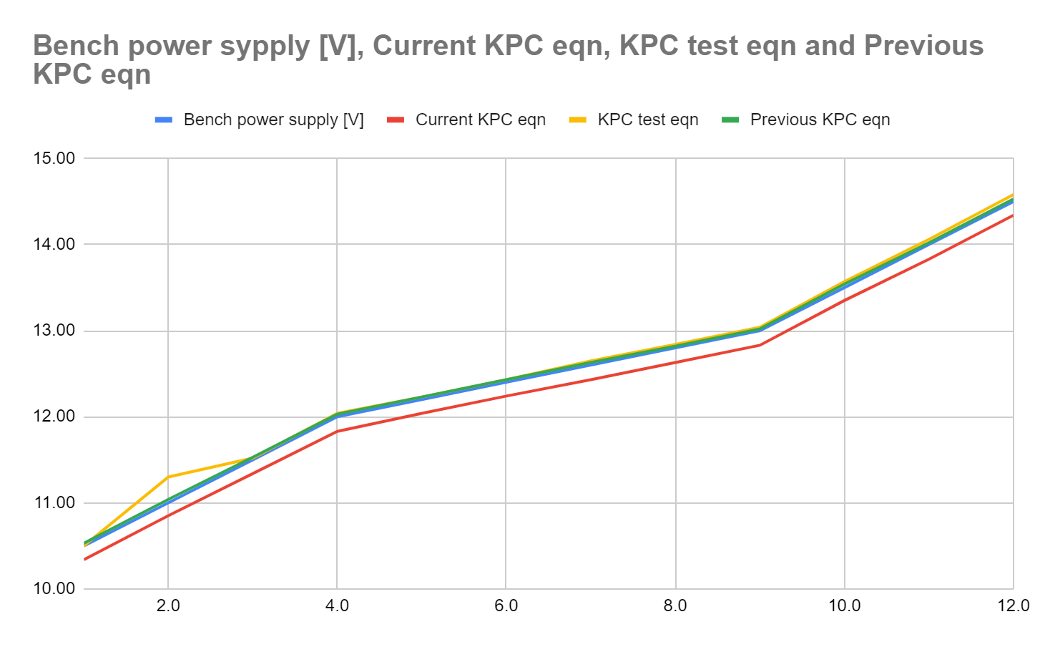
KPC System Voltage Equation Analysis
Bench test KPC was connected to a bench power supply. Voltage was varied stepwise from 10.5 to 14.5V and the corresponding KPC system voltage value obtained from the serial monitor.
Results
Analysis
A consistent error of -0.17V was observed between the power supply voltage and KPC system voltage.

Slide 12
Cont’d KPC System Voltage Equation Analysis
KP test
Two fully assembled KP in prod-int were charged to full capacity then mains turned off to let the KPs discharge gradually on battery.
Battery terminal voltage, UPS output terminal voltage and voltage at KPC port 1 were measured at intervals with a multimeter as the battery discharged, until the battery terminal voltage reached 12.0V.
The KPC system voltage reading (tablet display voltage) was also read off from the maintenance interface.

Slide 13
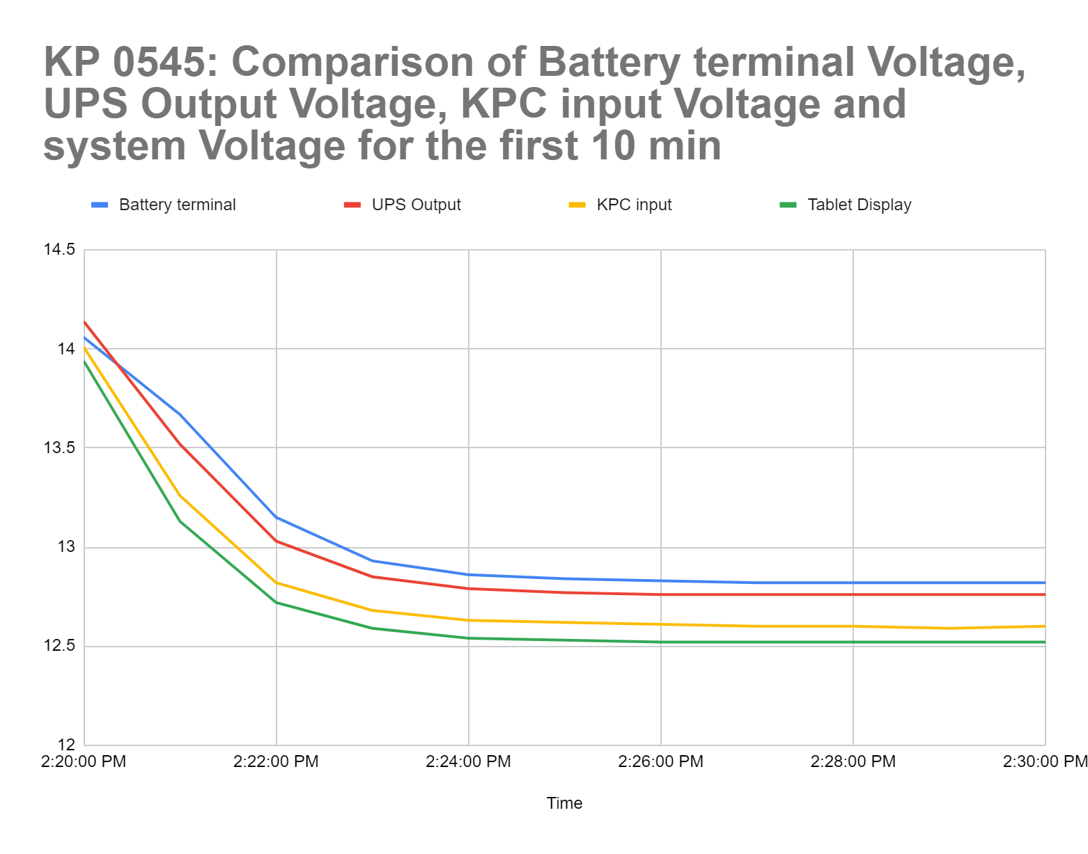
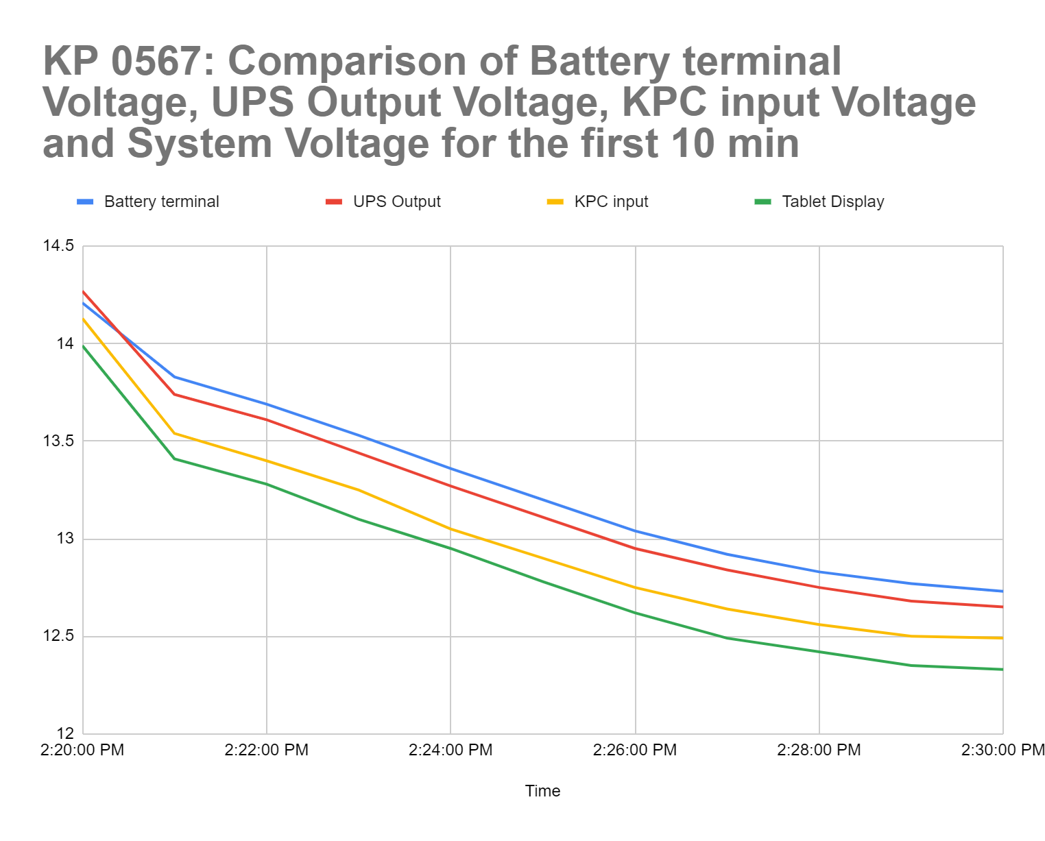
Cont’d KPC System Voltage Equation Analysis
Results - first 10 minutes of discharge

Slide 14
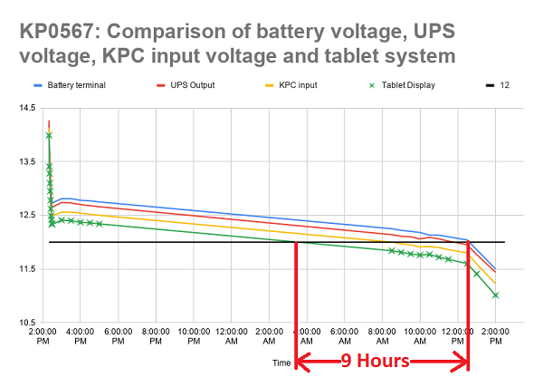
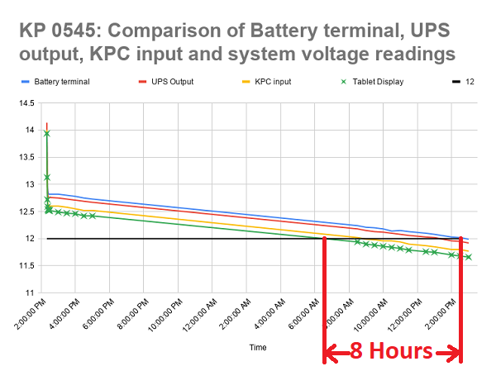
Cont’d KPC System Voltage Equation Analysis
Results - 24 hr duration

Slide 15
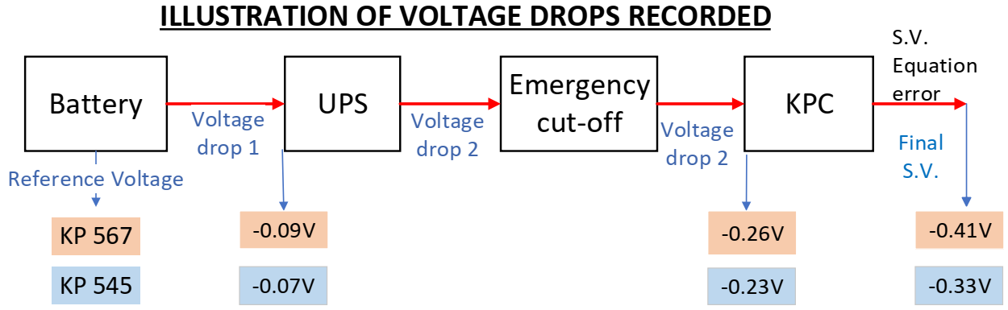
Cont’d KPC System Voltage Equation Analysis
Analysis: Consistent voltage drops were recorded in both KPs as illustrated below.

Slide 16
Cont’d KPC System Voltage Equation Analysis
Observed
KP0567 loses 8 hours and KP0545 loses 9 hours of service using the current method of reading system voltage.
KPC system voltage value takes the KP out of service (due to low battery) long before the battery terminal voltage reaches 12.0V.
Recommendation
Add an offset of 0.4V to system voltage equation to compensate for the voltage drop across DC power cable, emergency cut off, battery to UPS cables and system voltage equation reading error.
(i.e. Proposed s.v. equation = current s.v. equation + 0.4V)
This will increase duration of KP running on battery from 9h to about 22h.

Slide 17
Faulty Battery Analysis
Determine if some of the batteries in the field are genuinely faulty
Test Setup
Suspected faulty batteries were retrieved from the field and installed in inhouse KPs. Charged for 48h and then the KPs were allowed to run on battery. The duration it took for each of the batteries to discharge to a system voltage value of 12.0V was recorded.
Results
 | Field KP ID | Batt. serial | Duration batt. lasted in the field | Internal batt. resistance | Duration it lasted on battery in inhouse KP
1 | KP-0176 |  | 3h 00min | Batt. couldn’t be retrieved (shop closed)
2 | KP-0238 | KPR41S0236 | 5h 15min | 7.97mΩ @13.94V | 4h 19min
3 | KP-0164 | KPR41S0212 | 6h 00min | 7.95mΩ @13.66V | 6h 47min
4 | KP-0101 | KPR41S0133 | 5h 19min | 8.60mΩ @13.78V | 7h 47min

Slide 18
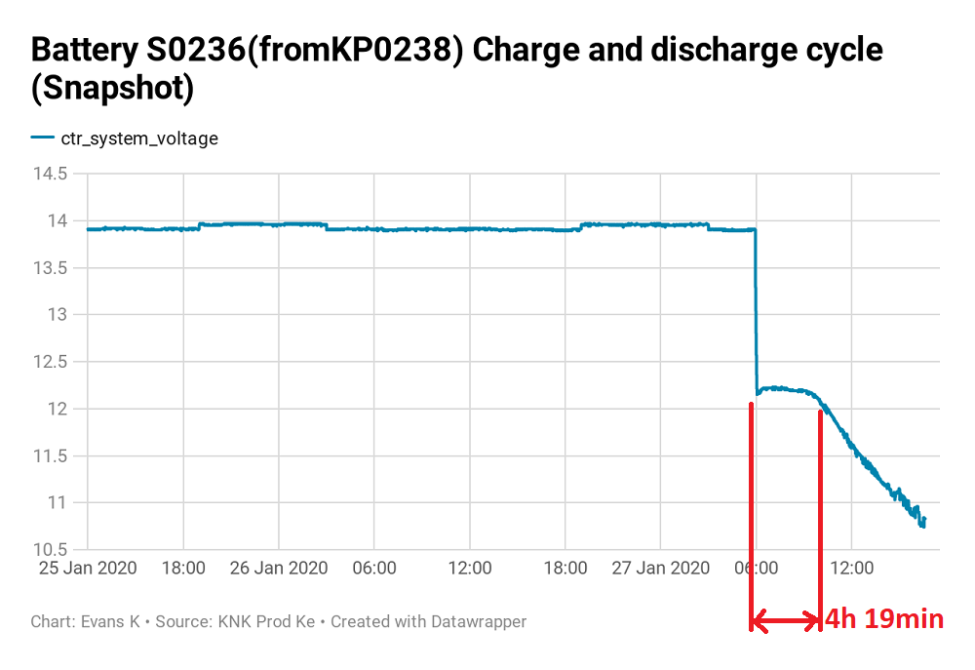
Cont’d Faulty Battery Analysis

Slide 19
Cont’d Faulty Battery Analysis
Analysis
All sampled batteries lasted less than 9h.
Internal battery resistance remained unchanged, compared with datasheet reference of 8mΩ.
Recommendation
Manufacturer Response
Improper charging of the batteries
Battery went bad due to long storage time without charging during warehouse storage or during shipping

Slide 20
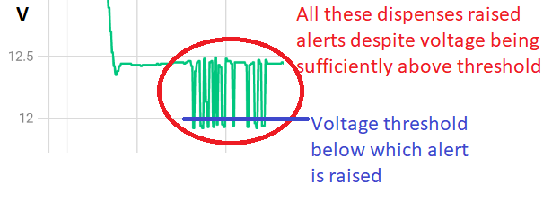
Conclusion
Short term solution
Communication:
CS to communicate to agents to keep KPs on mains at all times to allow the battery charge to full capacity - they only save KSh. 20/month by switching OFF the KP at night.
NOC to identify misleading battery low alerts which are generated by the system following a dispense when battery level is close to threshold. If customers experiences these alerts on subsequent dispenses when system voltage is close to but above 12.0V, a 1 min delay should be allowed between dispenses to allow the system to recover.

Slide 21
Cont’d Conclusion
Update the system voltage equation on the KP controller
i.e. Recommended equation = current equation + O.4V.
Benefit is KP will last longer on battery approximately 22 hours, this action will require replacement of 18UPS whose cut-off threshold is ≥11.5V
Follow up with manufacturer in regarding faulty batteries under warranty.
Long term proposed recommendation
Raise max charging current limit of UPS to reduce battery charging duration
This will require re-designing UPS to deliver max 8A battery charging current, hence charging duration shall drop to about 10h (constant current charging method).
This will solve agent related issues where the agents switch off power at night.

Slide 22
Action items
Software and Product
Lower threshold for battery low alert from 12V to 11.6V
Production Engineering
Identify UPS in the field with cut off voltage less than 11.5V
Follow up with manufacturer regarding faulty batteries - Done

Slide 23
Further details
Graphical results for in-house battery longevity tests
Results of the KPC system voltage bench test
Results of KPC system voltage equation accuracy investigation -KP setup

